Slide 1
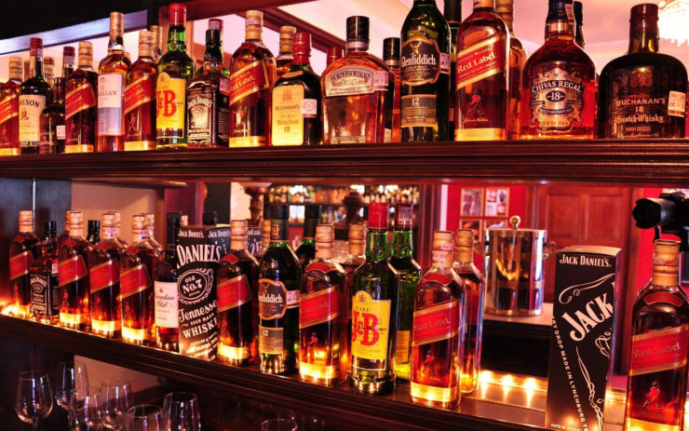
Bar-Beer-Drinker PLUS project demo
By group 66
Yuyang Cheng & Zihao Ding
Notes:
Background picture from: http://thenotebookgamer.com/great-bar-wallpaper-graphics-with-regard-to-household/

Slide 2
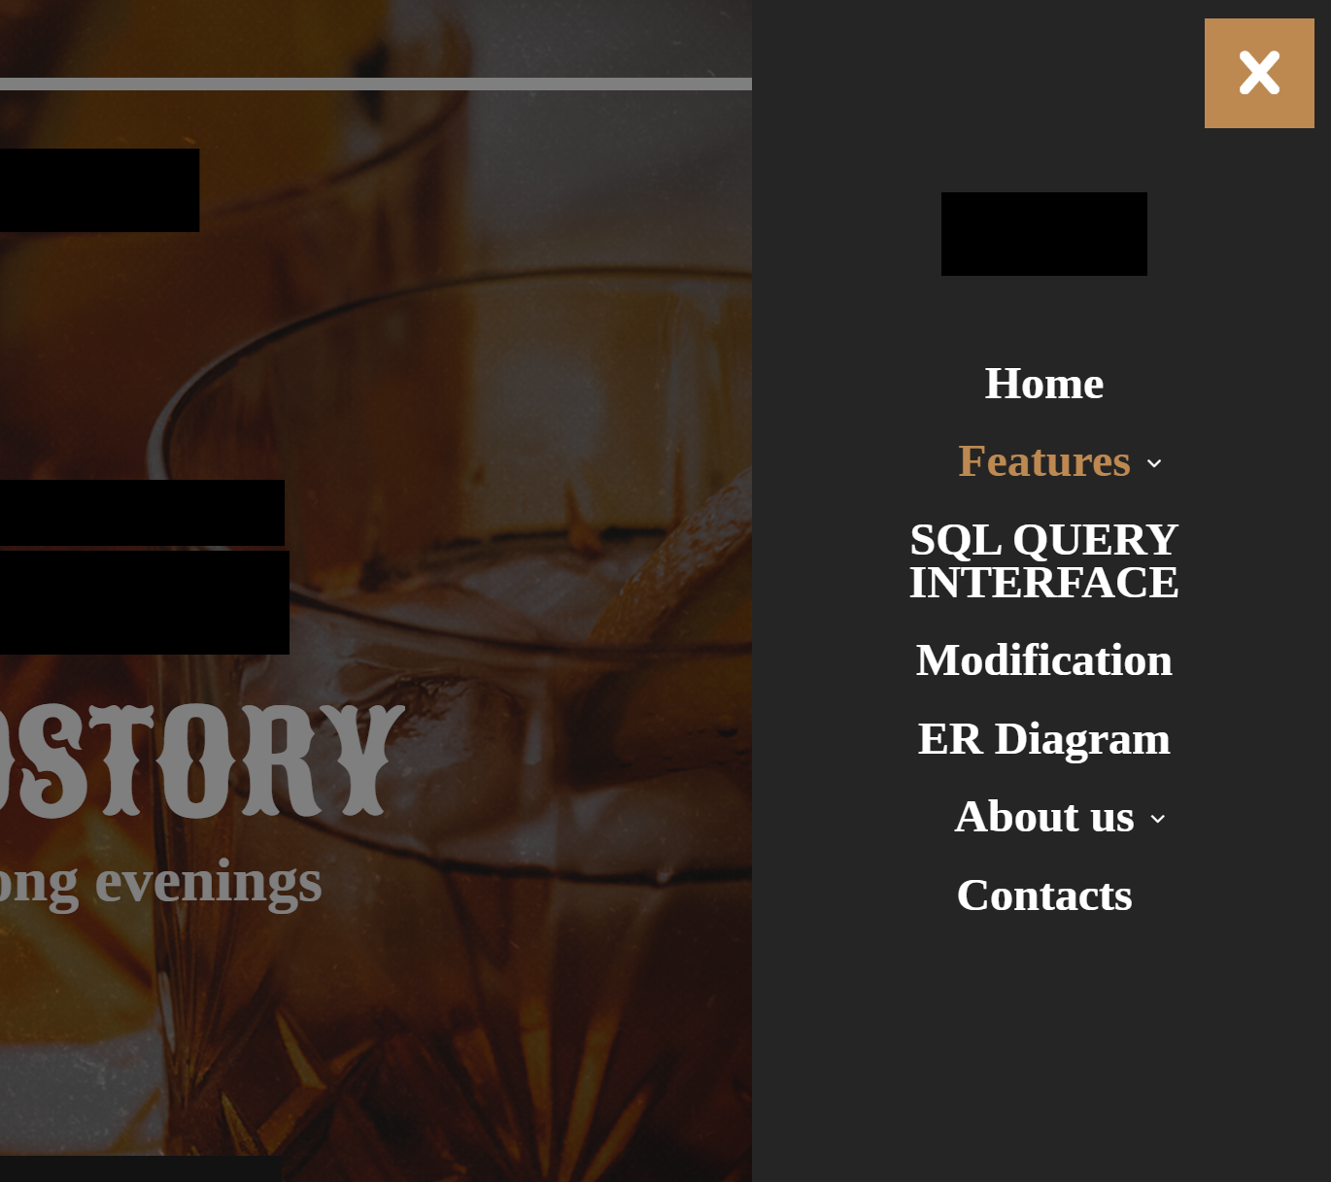

Home Page
General information about who made the page.
Use Menu icon to go to the other pages.

Slide 3
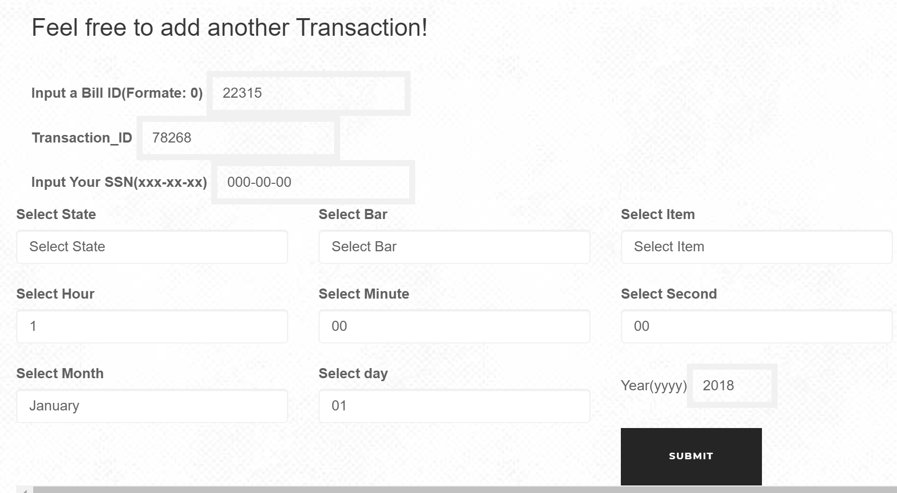
Bar Page
Our bar page includes following:
Tables: Bar Table, Bill Table, Transaction Table
Graphs : see next page.
Add more Transaction. (At the bottom of page)
* It may takes two seconds for page to fully loaded.

Slide 4
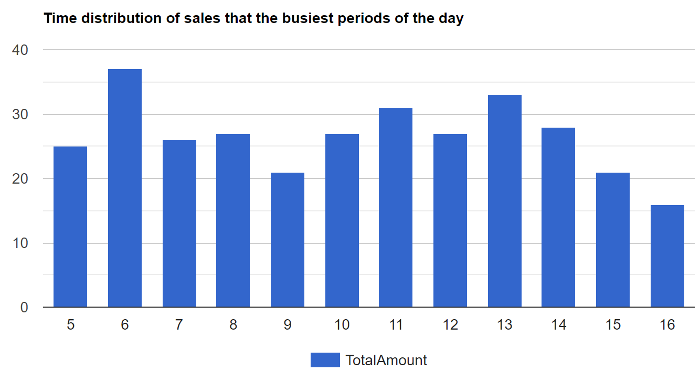
Bar Page - Graphs
Graphs in the Bar page includes following:
Top 10 Drinkers who spent most in a Bar
Top 10 popular beers in a Bar
Manufacturers who sold most beers in a Bar
Time distribution of sales in a day of the Bar
Time distribution of sales within a week of the Bar
(Just enter a Bar’s License# in the Bar table)

Slide 5
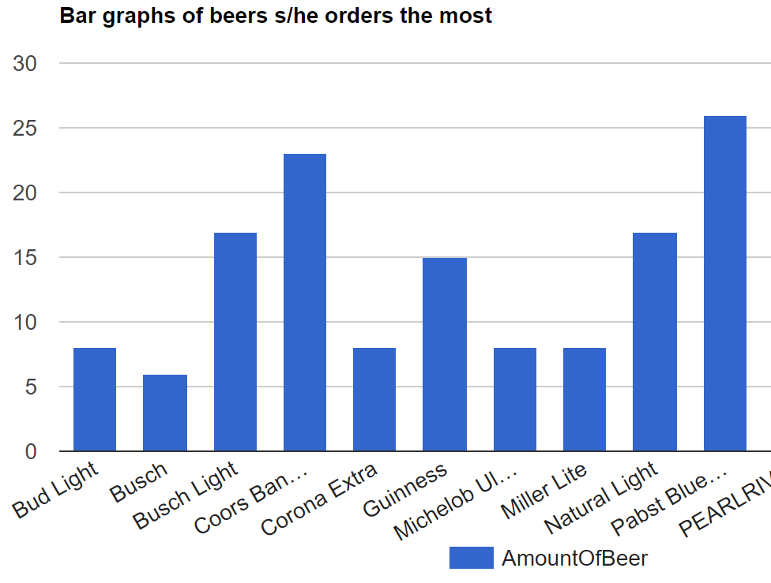
Drinker Page
The drinker page includes following:
Tables: Drinker Table, Bill Table, Transaction Table
Ones transactions Table ordered by time and grouped by different bars
Graph of beers one ordered most.
Graph of ones spending in different bars during different time period.
* It may take a second for page to fully loaded.

Slide 6
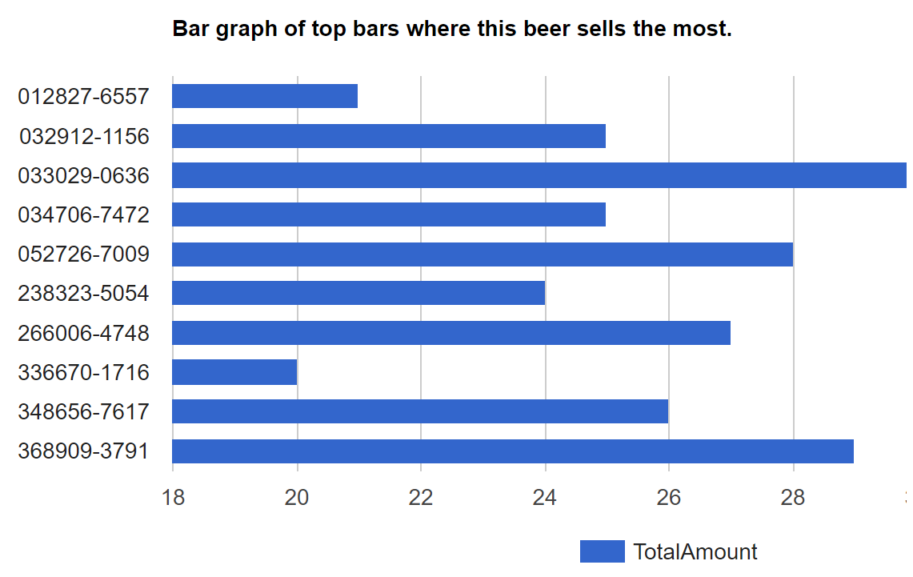
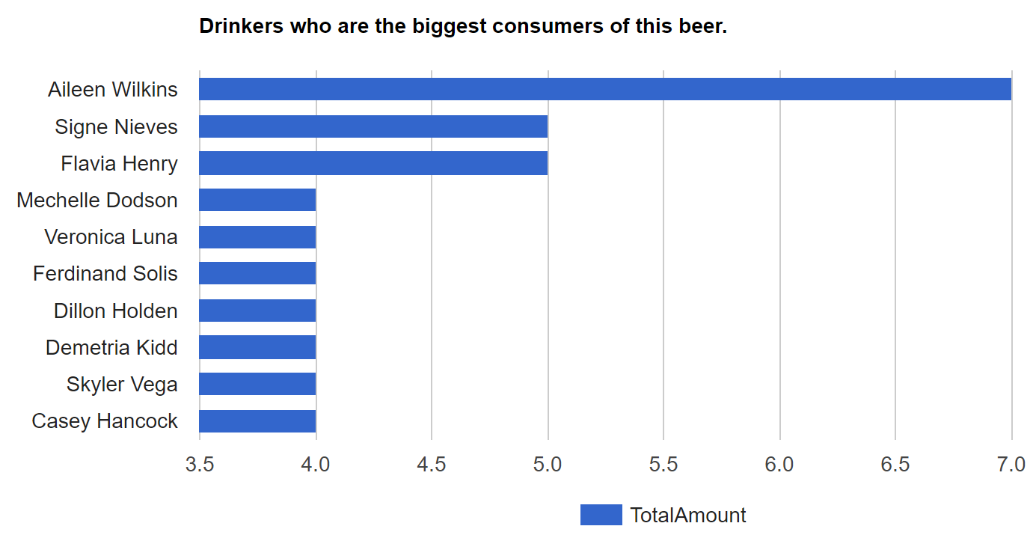
Beer Page
The Beer page includes following:
Table: Beer Information Table.
Graph of Bars who sell the most amount of the beer.
Graph of Drinkers who purchased the beer more than others.
Time distribution of when the beer sells most.

Slide 7
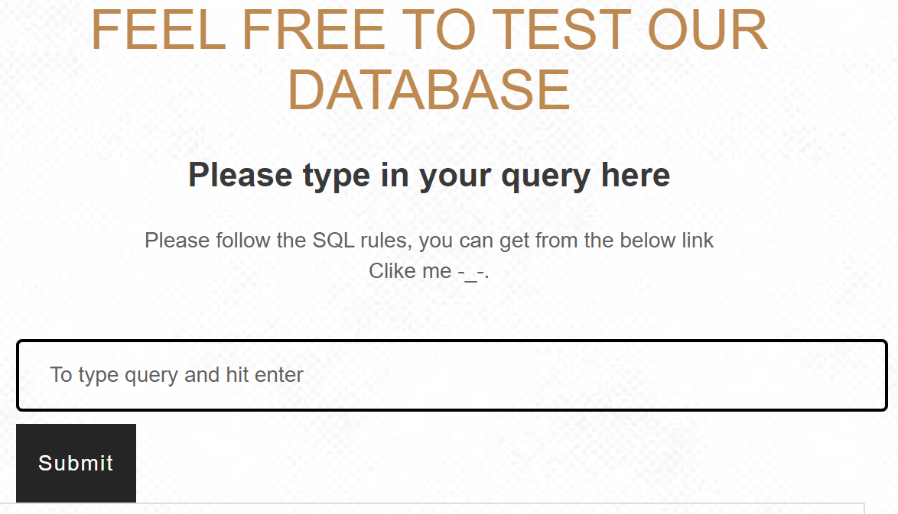
SQL QUERY INTERFACE
On this page, there is a Relational Scheme which will give user some idea about our data base. Below the Relational Scheme is the box where user can input all SQL queries.
(To check ER diagram, just click Menu on the top right corner and then choose ER diagram.)

Slide 8
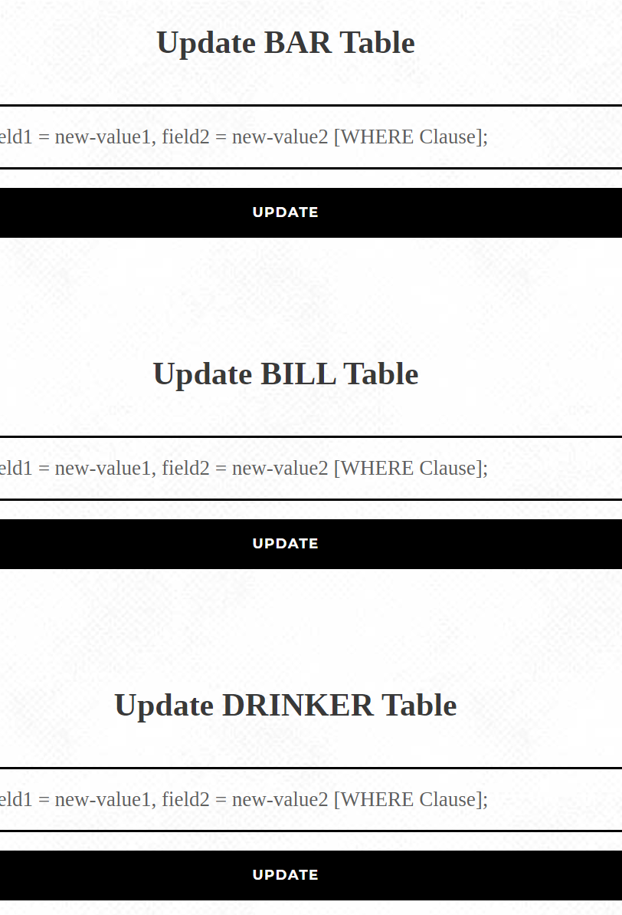
Modification Page
In this page, user can modify all the tables “freely”. Those queries that against the “rules” will not be add to the database due the triggers set in those tables.
(There is a Relational Scheme on top of page for reference. )

Slide 9
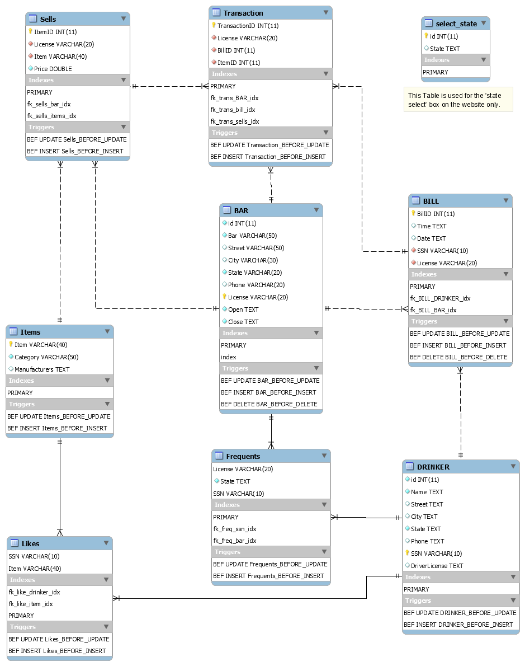
ER-Diagram Page
Display the ER Diagram of the Database.

Slide 10
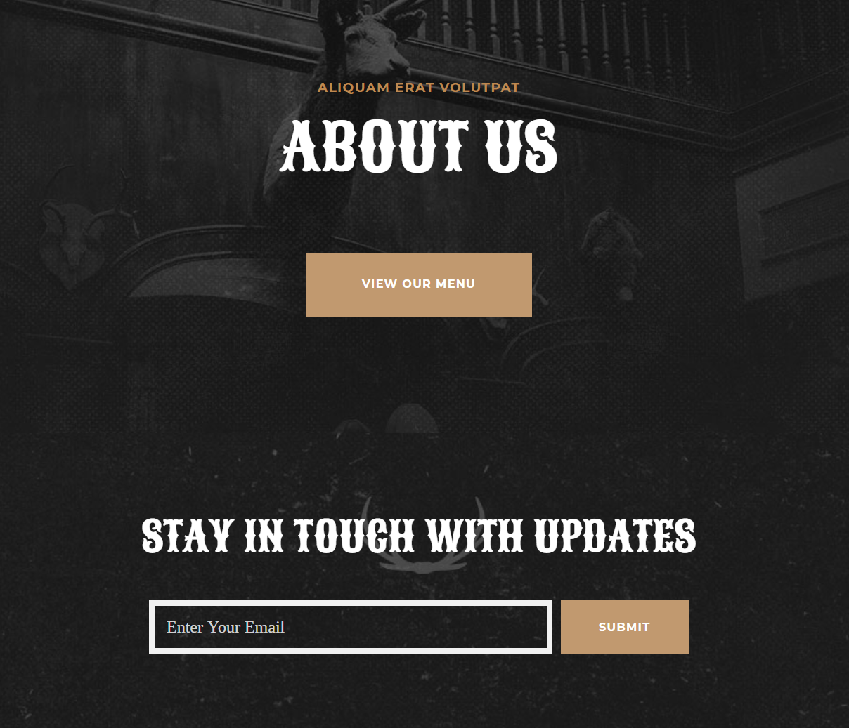
About us Page
Display the information of our group and how to get connect with us.

Slide 11
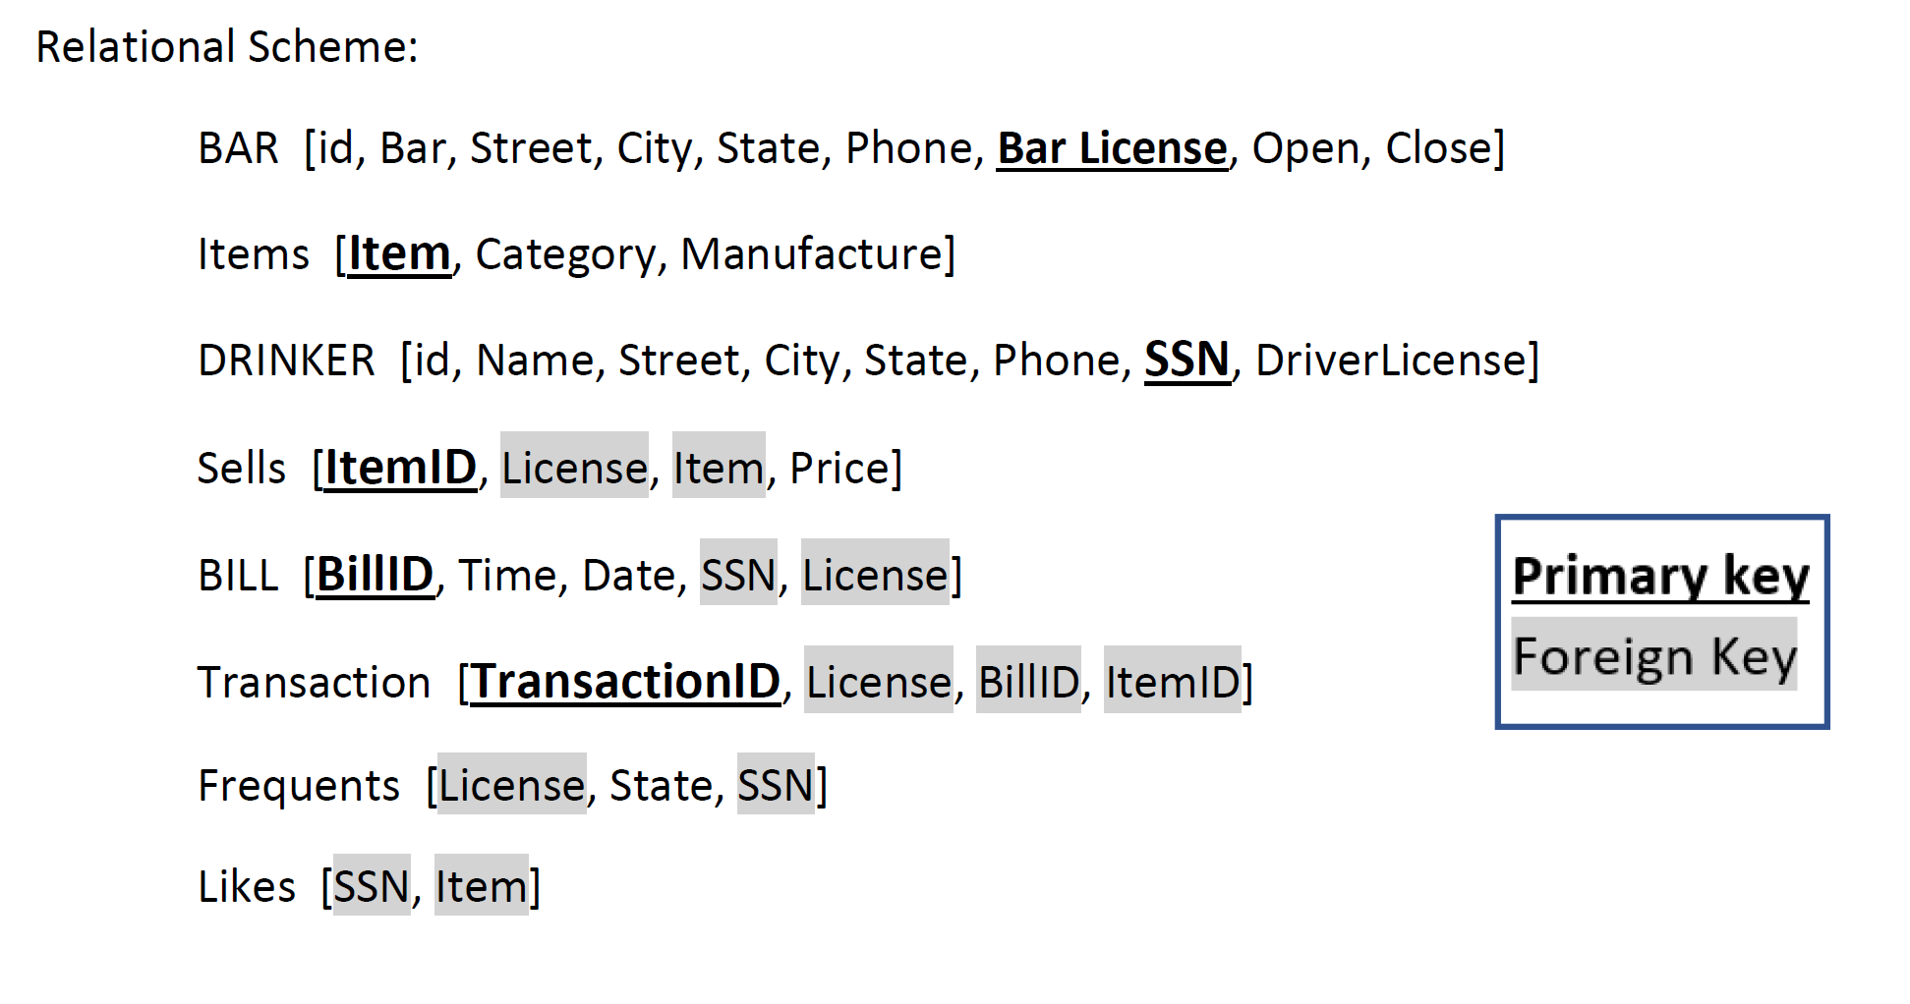
Relational Scheme of Database

Slide 12

That’s all
THANK YOU !
Notes:
Background image from https://wall.alphacoders.com/big.php?i=413078

